Slide 1
ETL Pipeline Design
A Graduate Project Mid Term Report submitted to Manipal Academy of Higher Education in partial fulfilment of the requirement for the award of the degree of
BACHELOR OF TECHNOLOGY
in
Electronics and Communication Engineering
Submitted by
Shivam Pathak
Reg No. 160907344
Under the guidance of
Internal Guide External Guide
Name - Dr. Somashekara Bhat Name - Mr Joseph Vinod Miranda Affiliation - Professor, MIT Manipal Affiliation - Senior Director, Data Management

Slide 2
About JLL
JLL is Commercial Real Estate Company
JLL Technologies supports the technical projects for various Cleints

Slide 3
Contents
Introduction
Background theory/literature review
Methodology – From data cleaning to building dashboards
Example of dashboards
Conclusion and future work
References

Slide 4
Introduction
Collecting and sorting data is a huge problem in today’s scenario
With so much data all around us, there is the problem of getting overwhelmed by the information that leads to information overflow
Data overflow is a huge problem in the real estate business.
Aim in this project is to streamline data for various client and teams at JLL

Slide 5
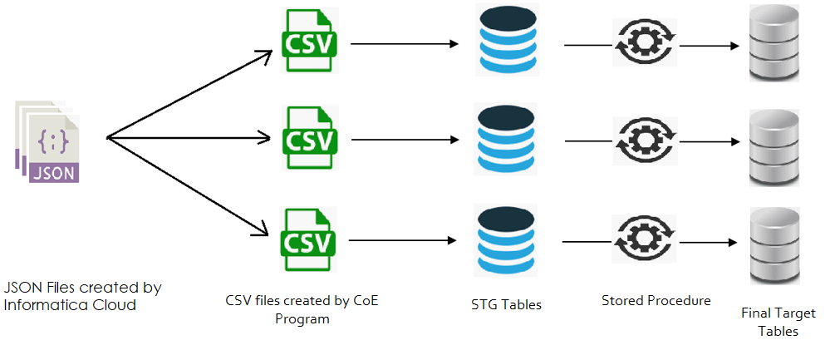
Handling Data
Extracting, transforming and loading the datasets into the data warehouse

Slide 6
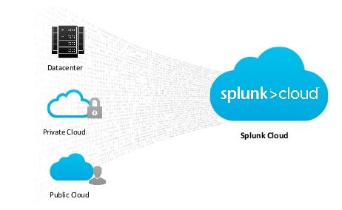
Methodology

Slide 7
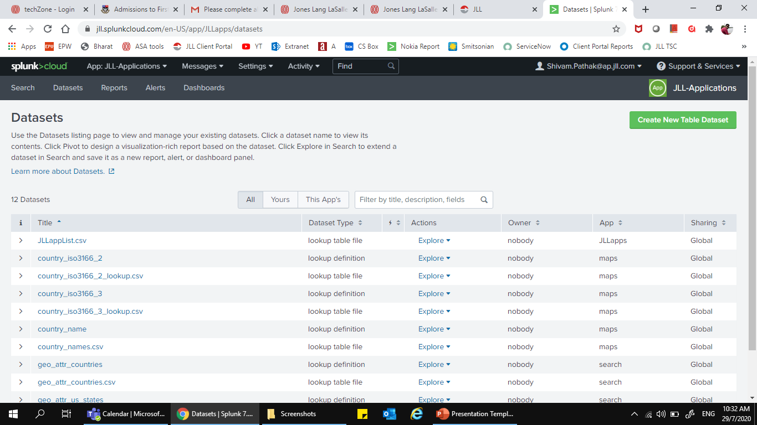
Methodology

Slide 8
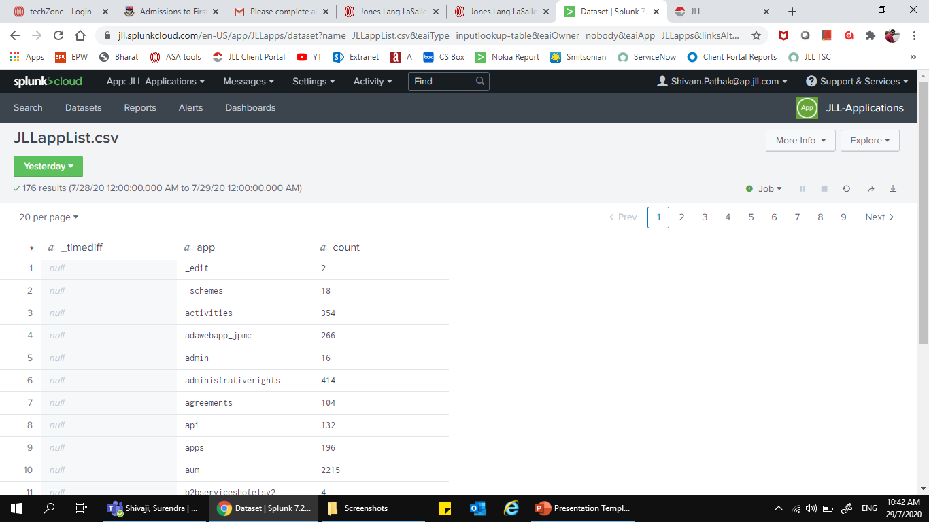
Methodology

Slide 9
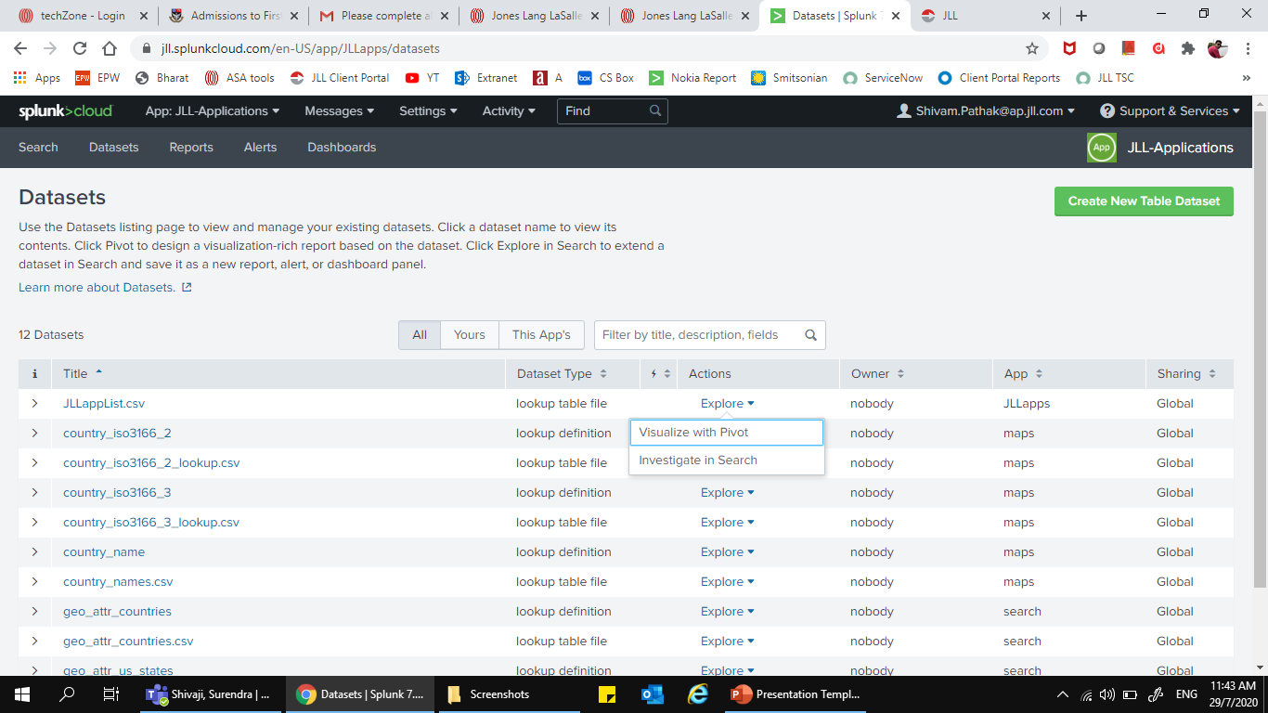
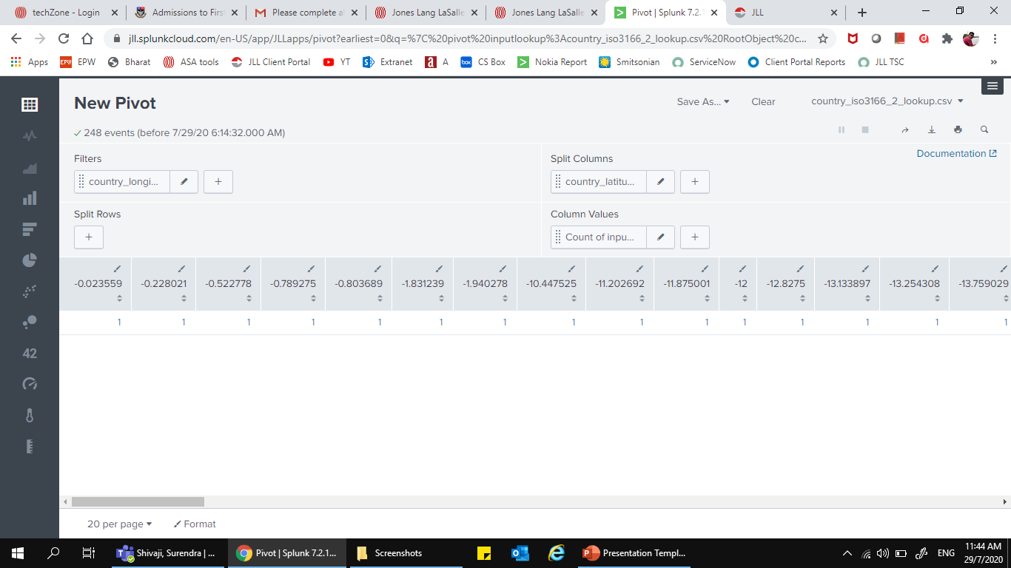
Methodology

Slide 10
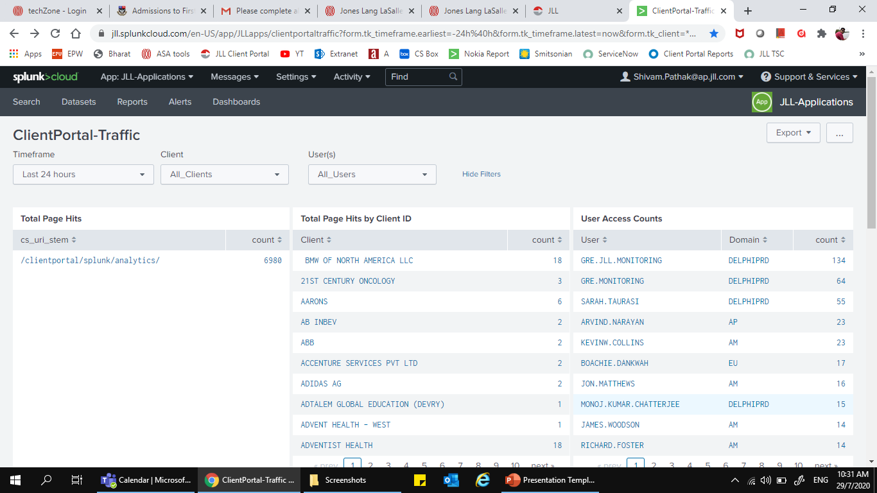
Methodology
Commercial Real Estate Clients in the America and Europe Region

Slide 11
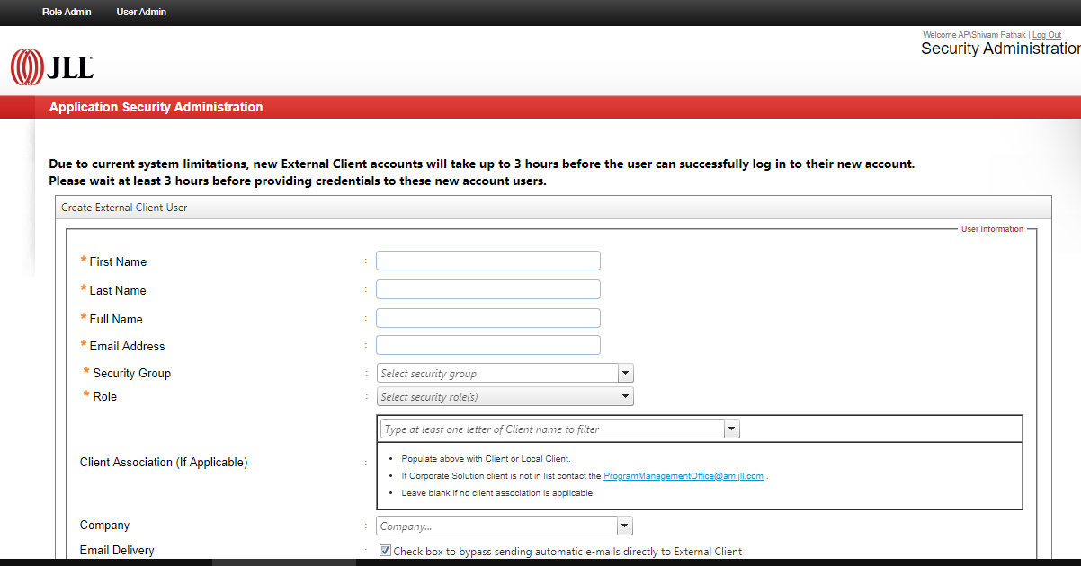
Methodology
How Clients get access to there reports?

Slide 12
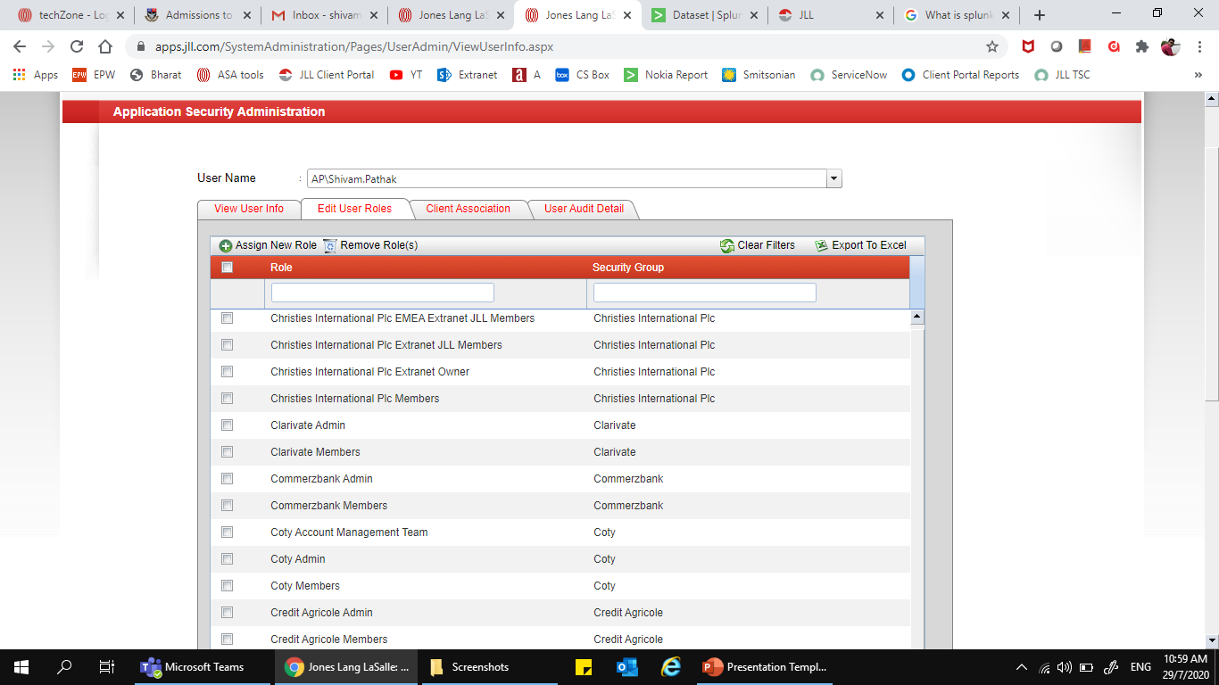
Methodology

Slide 13
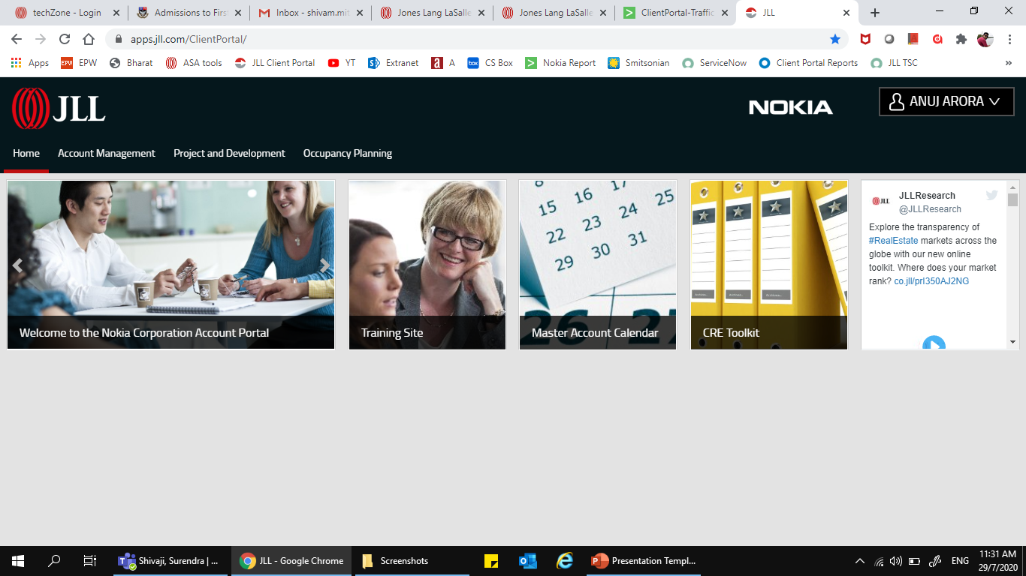
How Clients view the page

Slide 14
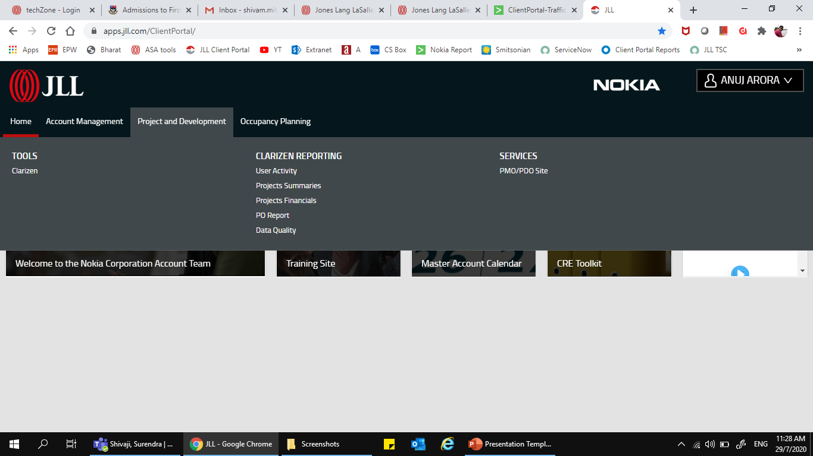

Slide 15
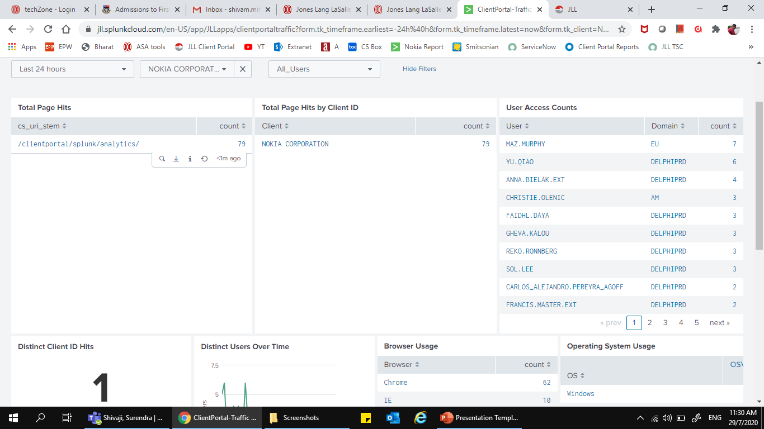
Example of the report of the Nokia

Slide 16
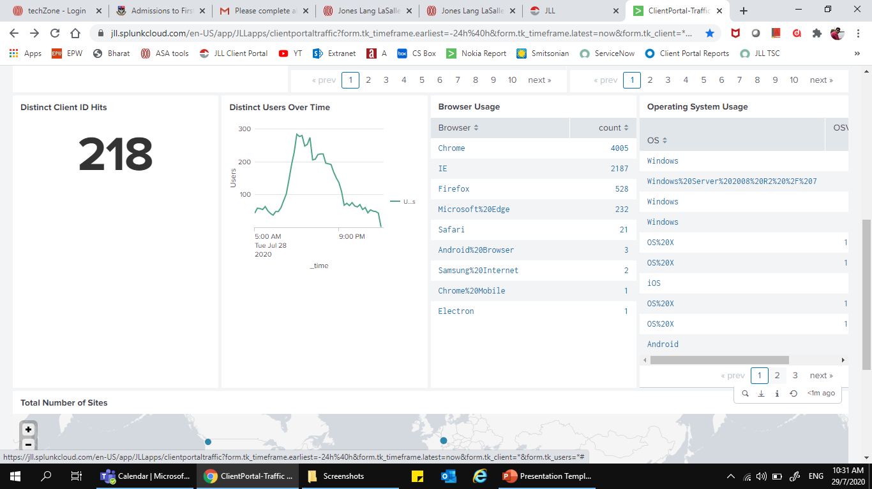
Example of the report of the Nokia

Slide 17
Conclusion and future work
Conclusion
Our aim is to streamline the data and make data handling easier for our business team.
Future Scope
Build the same tool for various other clients at JLL
Add a secure transmission channel for JLL so that the intermediate files are encrypted and could not be assessed without having the proper keys.

Slide 18
References
“Azure Databricks - A Complete Guide - 2019 Edition”, by Gerardus Blokdyk
Anaconda.org [Online].
Python.org/documentation [Online]
https://docs.aws.amazon.com/awsaccountbilling/latest/aboutv2/cost-alloc-tags.html [Online]
https://spark.apache.org/docs [Online]
Interactive Python Dashboards with Plotly and Dash
https://docs.microsoft.com/en-us/azure/
H. KT, "Hafeez KT", YouTube, 2020. [Online]. Available: https://www.youtube.com/channel/UCEXcqylc45jam5xa6vvEG7A. [Accessed: 14- May- 2020].

Slide 19
Thank you!

